Slide 1
Classification

Slide 2
Response is Qualitative
Predict disease based on symptoms
Predict if a transaction is fraudulent based on user ip, balance etc
Classification is task of predicting qualitative/categorical responses
Classifier is the function/model that assigns a category to a record/observation.

Slide 3
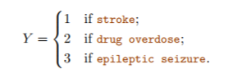
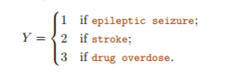
Why not linear regression
Suppose that we are trying to predict the medical condition of a patient in the emergency room on the basis of her symptoms.
Coding implies an ordering on the outcomes
Even if there was an implicit ordering in the qualitative responses such as mild, moderate , severe – what about the gap between them?
For a binary qualitative response the situation is a little better.

Slide 4
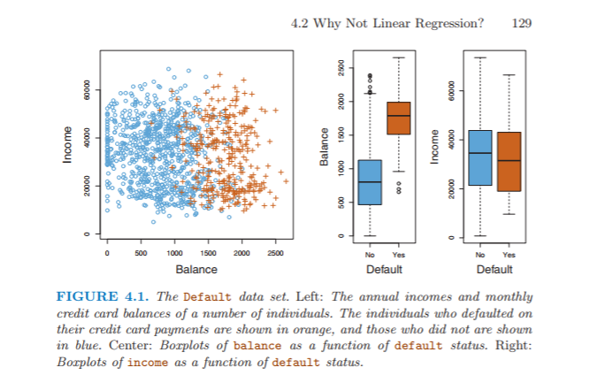
Default dataset
We are interested in predicting whether an individual will default on his or her credit card payment, on the basis of annual income and monthly credit card balance.

Slide 5
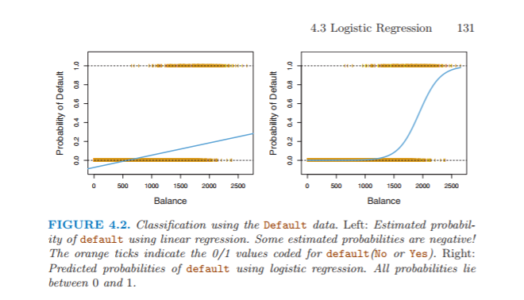
Logistic regression
Instead of modelling the response Y directly, logistic regression models the probability that Y belongs to a particular category.
Model = Pr(default = Yes|balance)
= f(balance)

Slide 6
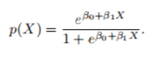
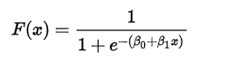
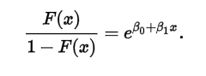
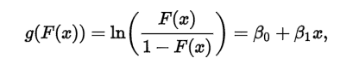
Logistic Model
How to model the relationship between f(X) = Pr(Y = 1|X) and X?
Odds :
Log-odds :
Log odds changes by β1 for unit change in X
The amount that f(X) changes due to a one-unit change in X will depend on the current value of X

Slide 7
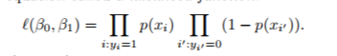
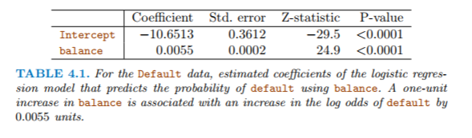
Regression coefficients
Maximum likelihood method is used for estimation.
Testing Significance of the coefficients

Slide 8
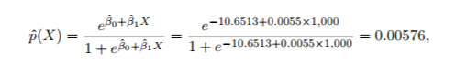
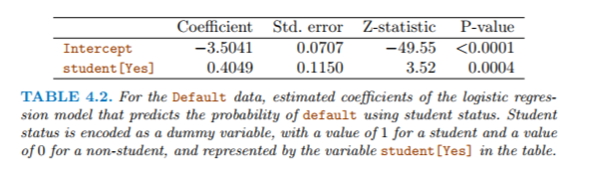
Making predictions
Simply substitute ☺
Ex : Probability of defaulting when credit card balance is $1000
Probability of defaulting when credit card balance is $2000 is 0.586
If we had qualitative predictor , use dummy coding.

Slide 9
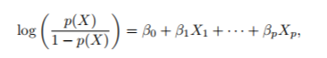
Multiple Logistic Regression
Predicting a binary response using multiple predictors
All the coefficients are estimated using Maximum likelihood

Slide 10
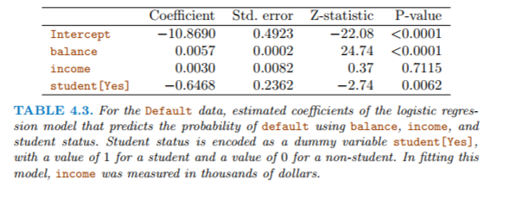
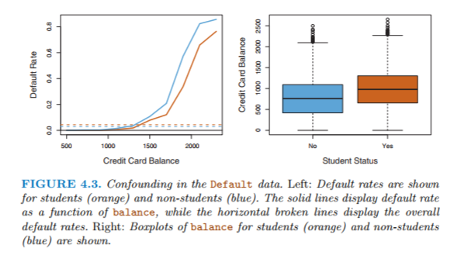
The results obtained using one predictor may be quite different from those obtained using multiple predictors, especially when there is correlation among the predictors.
Confounding: A situation in which the effect or association between an exposure and outcome is distorted by the presence of another variable.

Slide 11
Logistic Regression for >2 Response Classes
If we had three categories of medical condition in the emergency room: stroke, drug overdose, epileptic seizure then we model both
Pr(Y = stroke|X) and Pr(Y = drug overdose|X)
Then, remaining Pr(Y = epileptic seizure|X) =
1 − Pr(Y = stroke|X) − Pr(Y = drug overdose|X).

Slide 12
Linear Discriminant Analysis
Popular for multiple-class classification
We model the distribution of the predictors X separately in each of the response classes (i.e. given Y ), and then use Bayes’ theorem to flip these around into estimates for Pr(Y = k|X = x).
When the classes are well-separated, the parameter estimates for the logistic regression model are surprisingly unstable. Linear discriminant analysis does not suffer from this problem.
If n is small and the distribution of the predictors X is approximately normal in each of the classes, the linear discriminant model is again more stable than the logistic regression model.

Slide 13
Prerequisites Concepts Needed for LDA, QDA
Conditional probability
Bayes Theorem
Covariance matrix
Maximum likelihood estimation
Basic vector calculus
Multivariate normal distribution

Slide 14
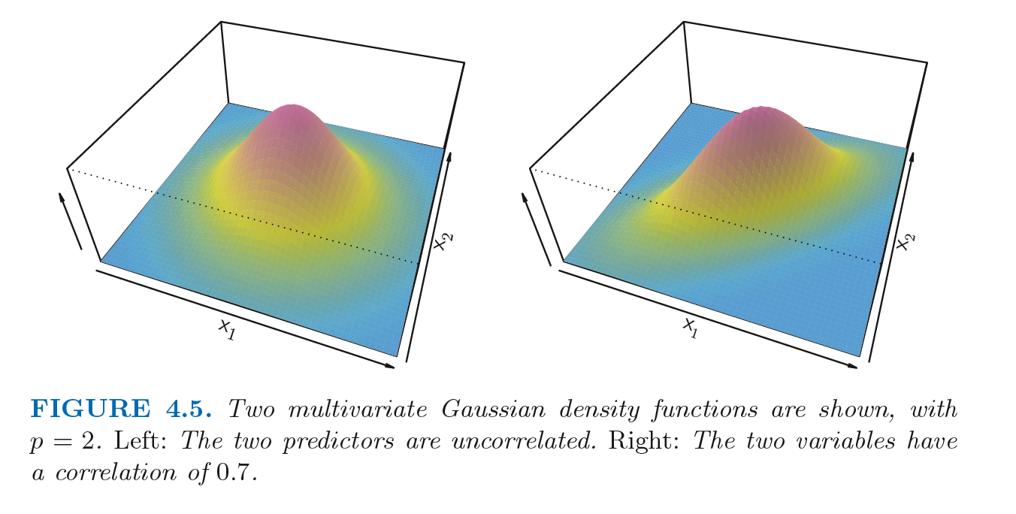
Multivariate normal distribution

Slide 15
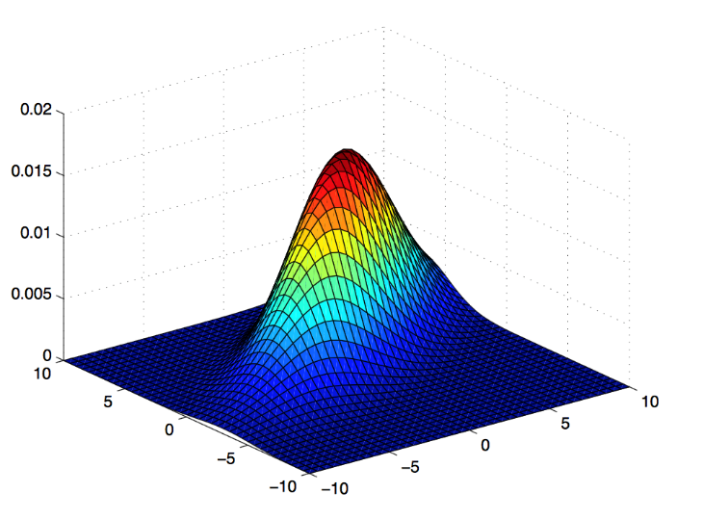
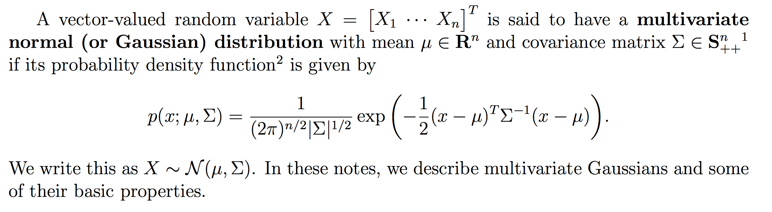
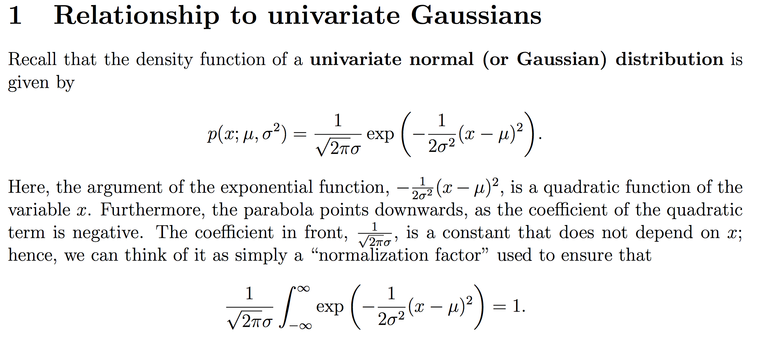
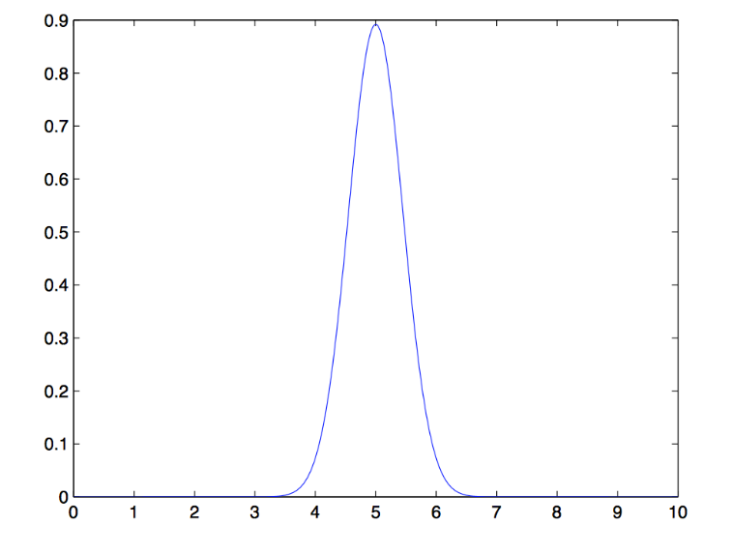
Multivariate normal distribution
http://cs229.stanford.edu/section/gaussians.pdf

Slide 16
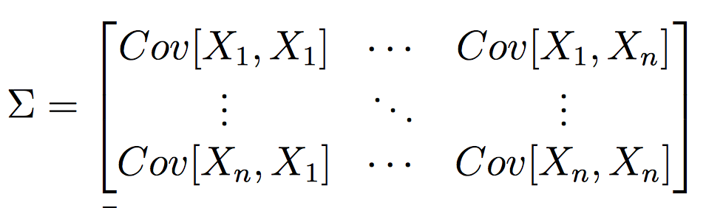
Covariance Matrix
http://cs229.stanford.edu/section/gaussians.pdf

Slide 17
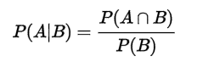
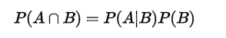
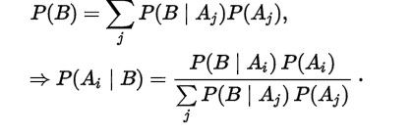
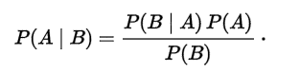
Conditional Probability
Bayes Theorem :
Extended Form :

Slide 18
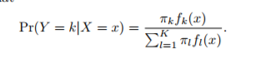
Linear Discriminant Analysis
Let πk represent the overall or prior probability that a randomly chosen observation comes from the kth class
Let fk(X) ≡ Pr(X = x|Y = k) denote the density function of X for an observation that comes from the kth class.
Then Bayes’ theorem states that

Slide 19
Assumptions for LDA
Data is Gaussian, that each variable is shaped like a bell curve when plotted.
That each attribute has the same variance, that values of each variable vary around the mean by the same amount on average.
By making this assumption, the classifier becomes linear

Slide 20
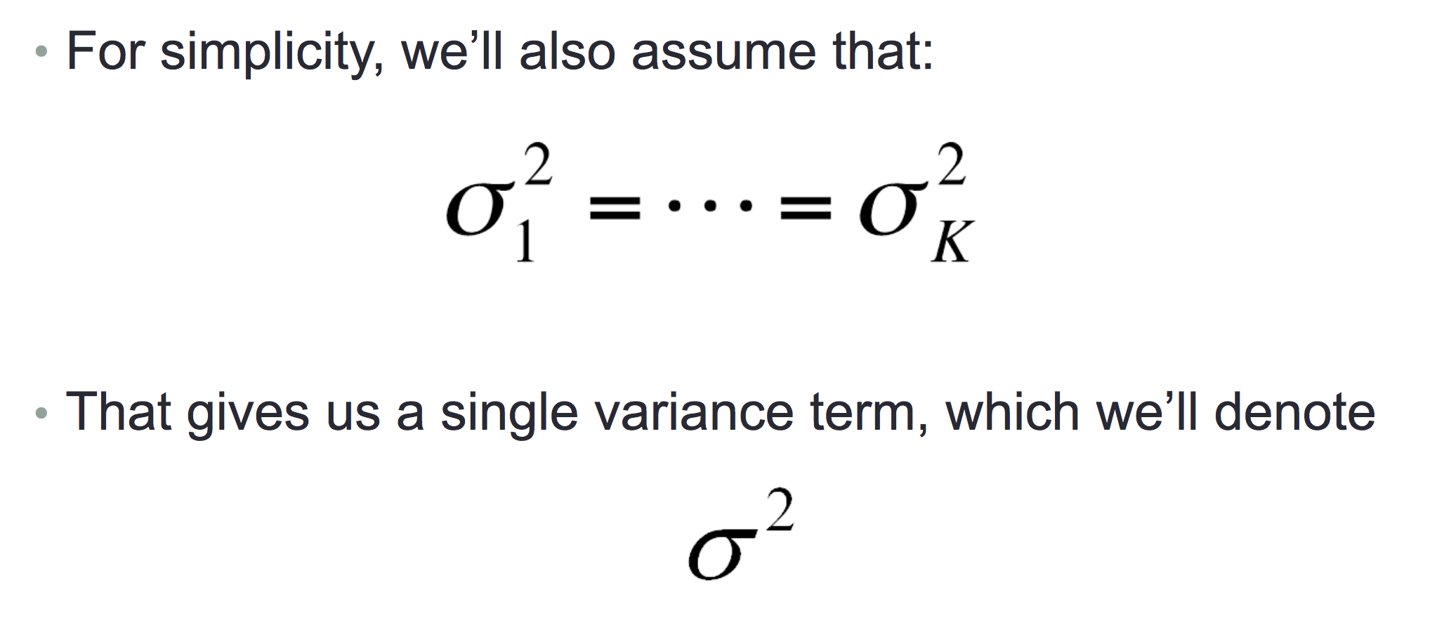
Assumption 2: classes have equal variance

Slide 21
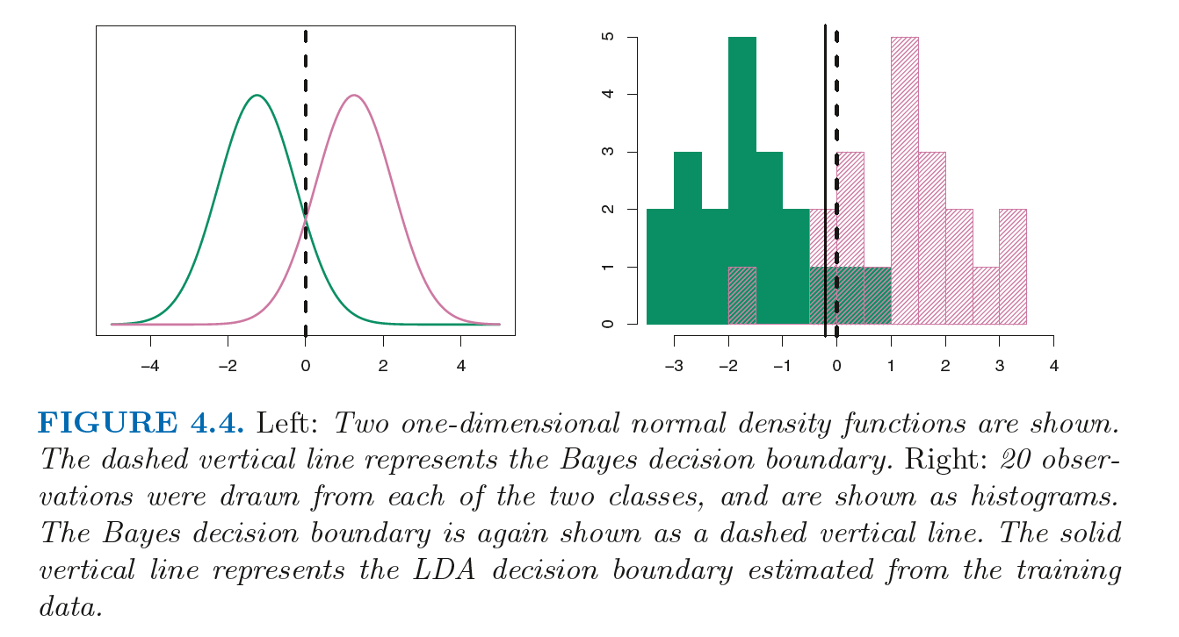

Slide 22
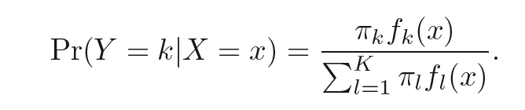
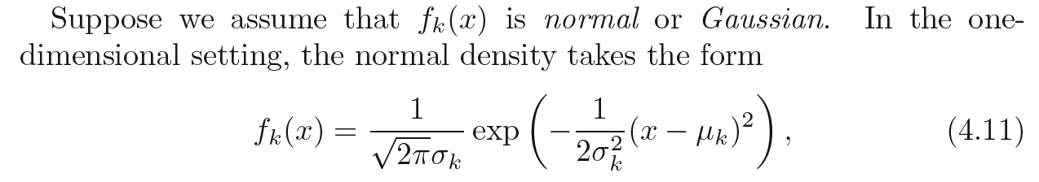
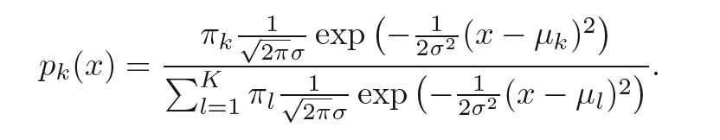
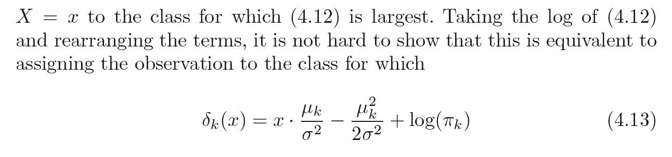
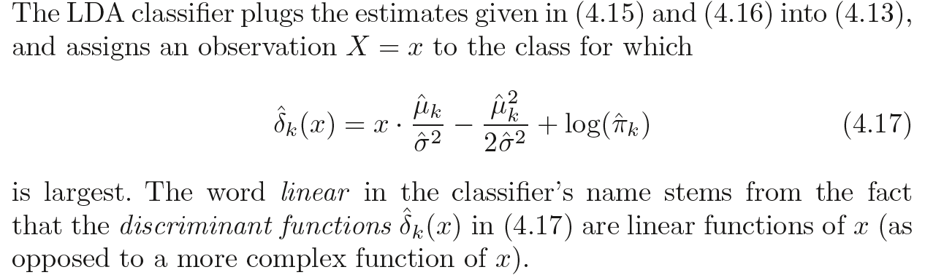
P = 1
Only on feature

Slide 23
LDA: pick a new dimension that gives
Maximum separation between means of projected classes
Minimum variance within each projected class

Slide 26
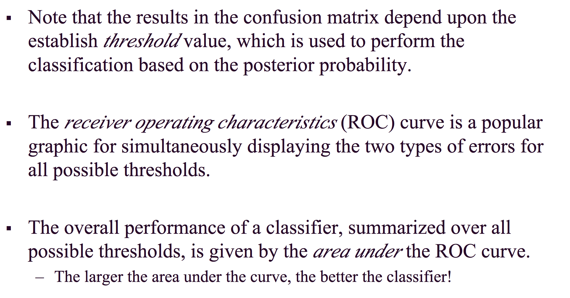
Performance of a Classifier

Slide 27
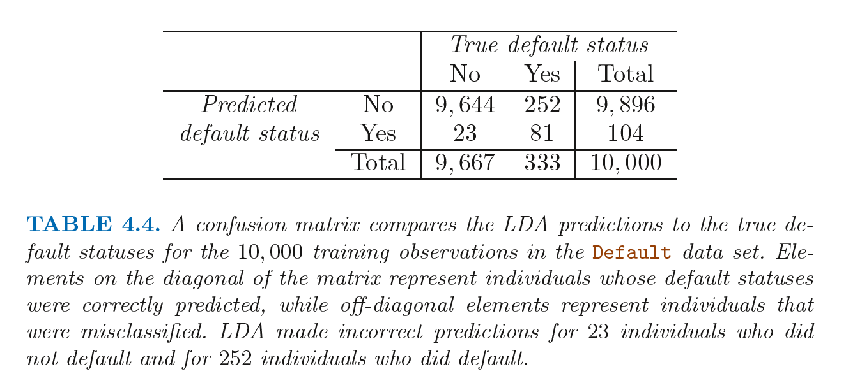
Confusion Matrix

Slide 28
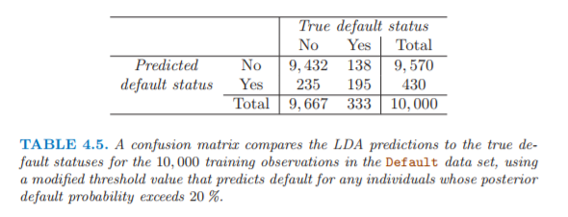
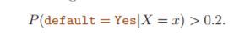
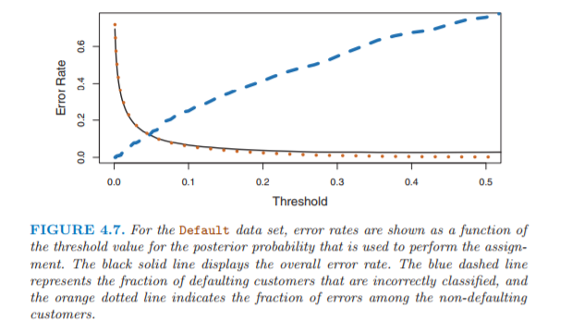

Slide 29
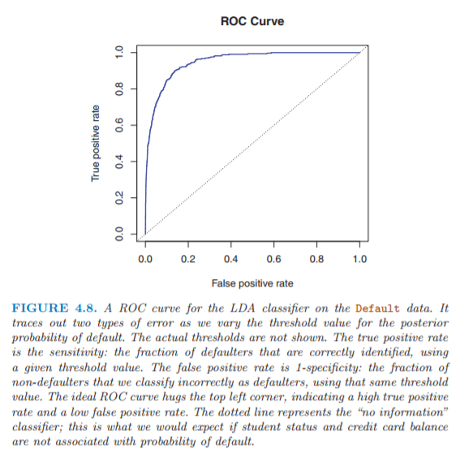
ROC-AUC

Slide 30
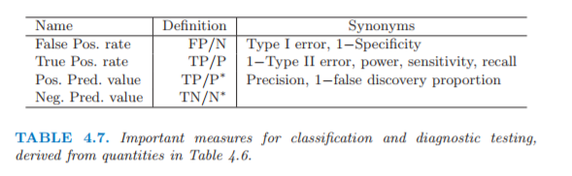

Slide 31
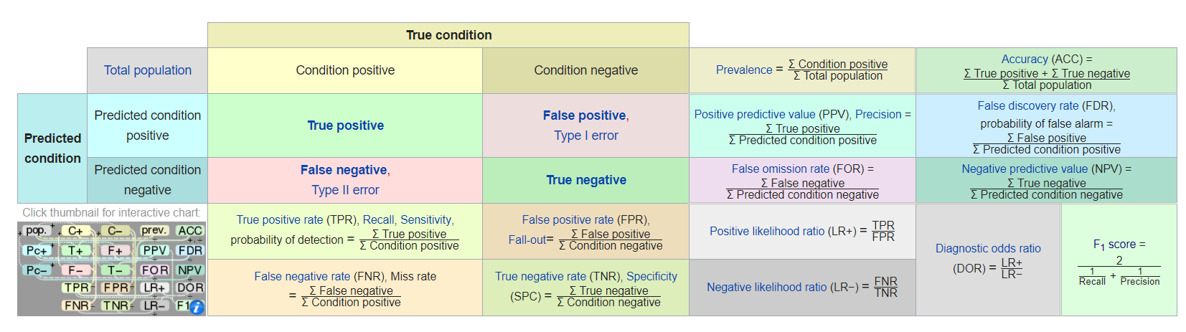

Slide 32
Quadratic Discriminant Analysis
Equal-variance Gaussian densities - Linear discriminant analysis
Unequal-variance Gaussian densities - Quadratic discriminant analysis
Covariance matrix can be different for each class
The decision boundary is determined by quadratic function
We get quadratic discriminant function

Slide 33
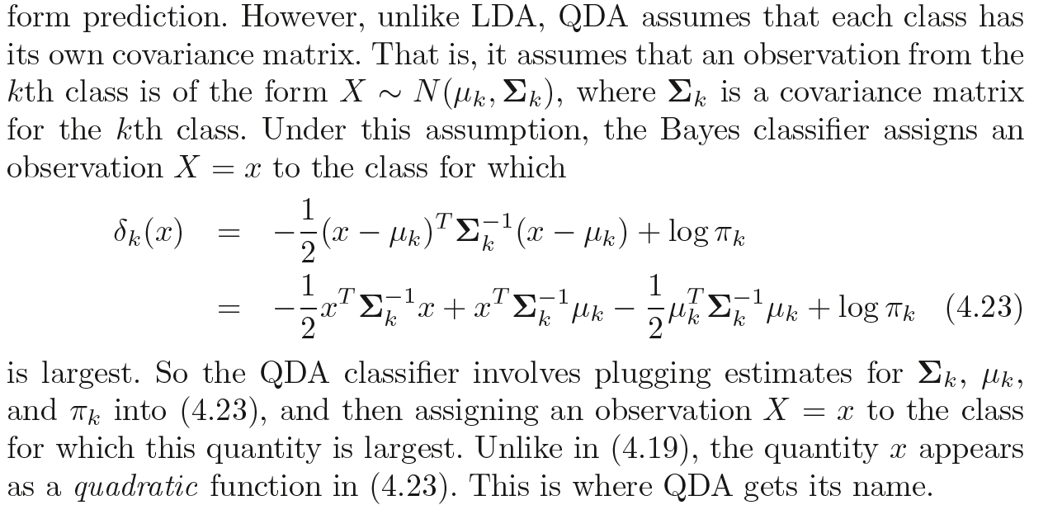
Quadratic Discriminant Analysis

Slide 34
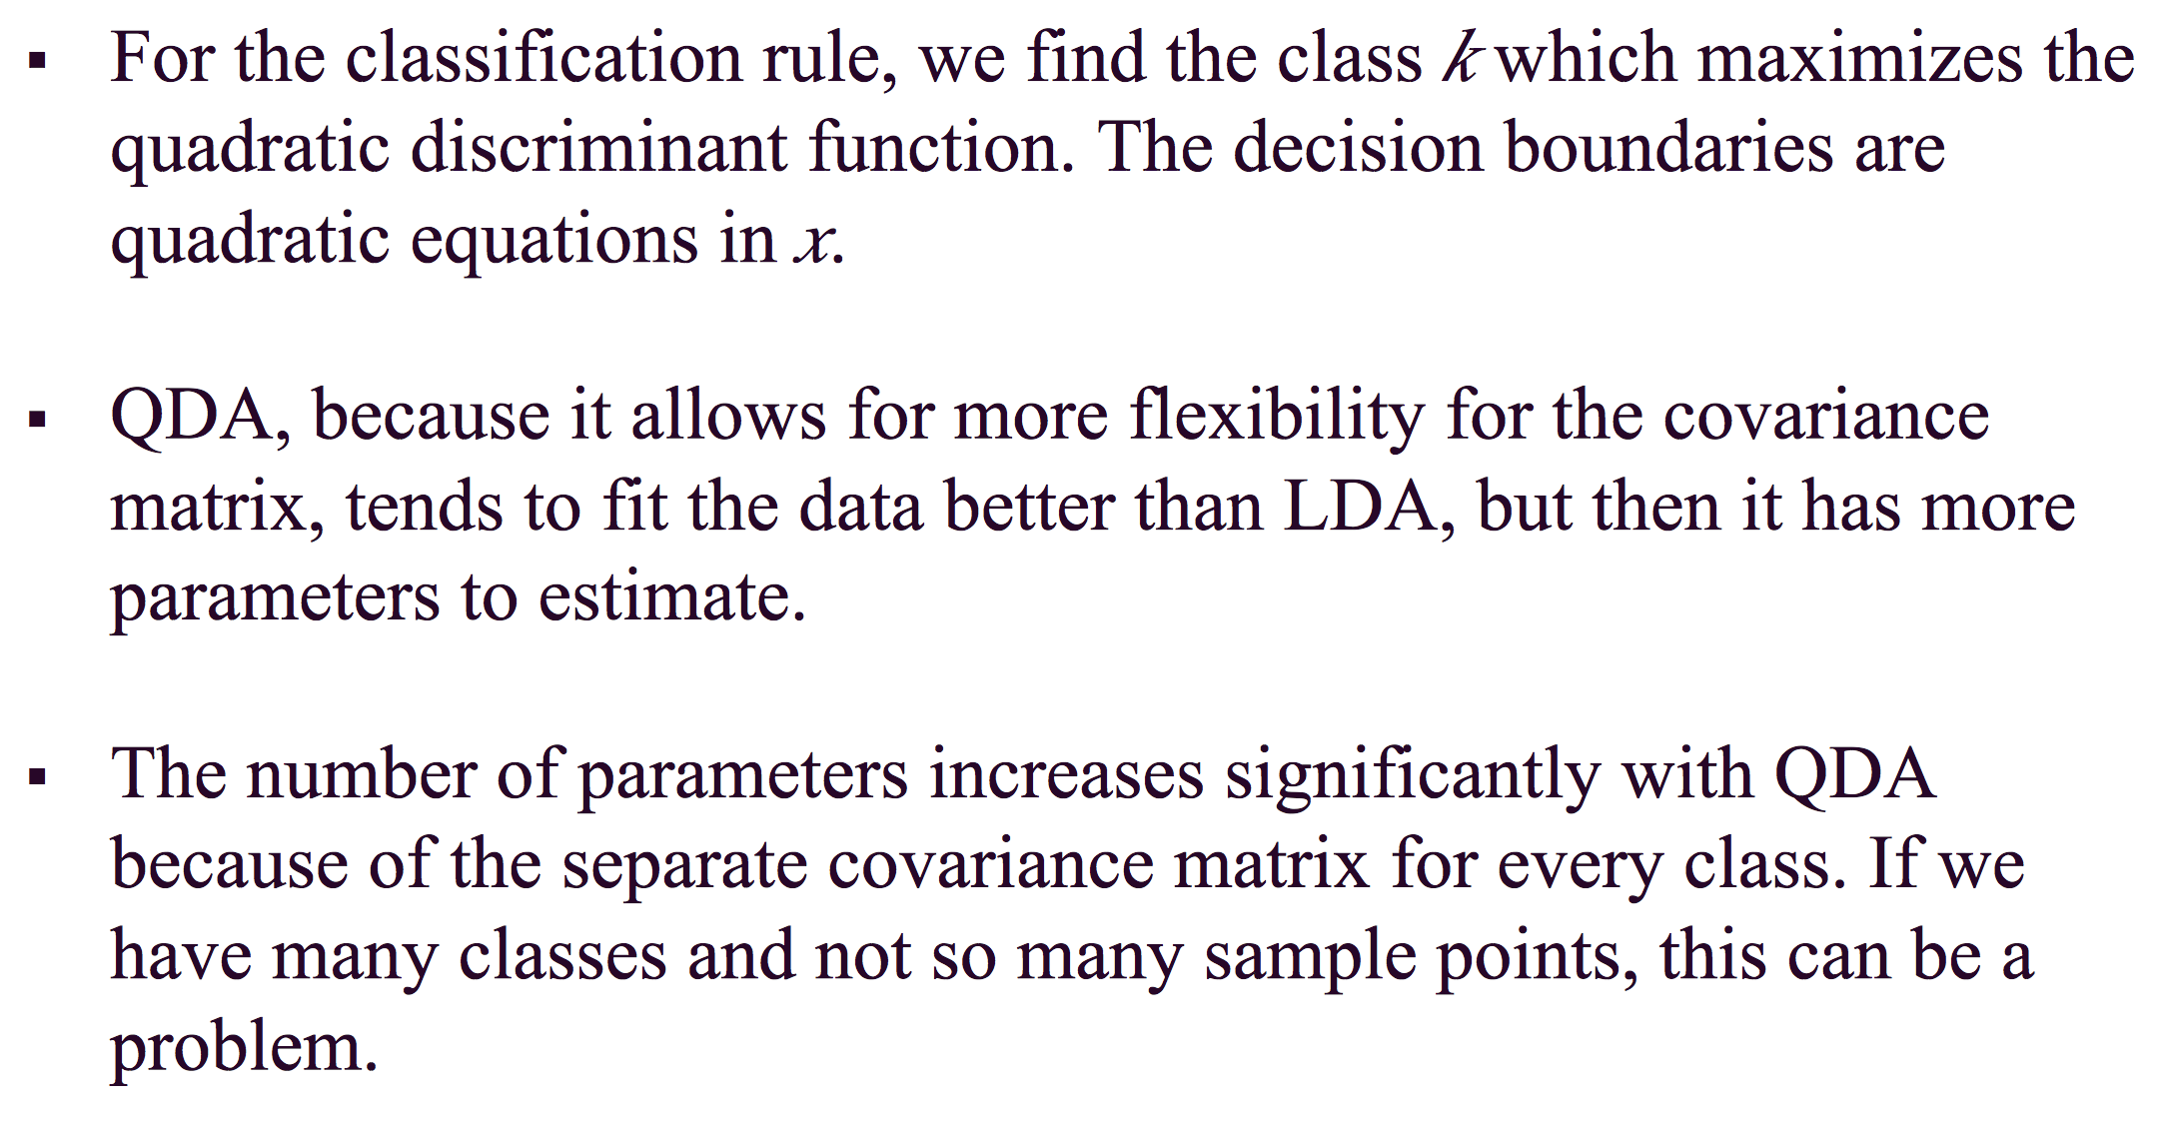
Quadratic Discriminant Analysis

Slide 35
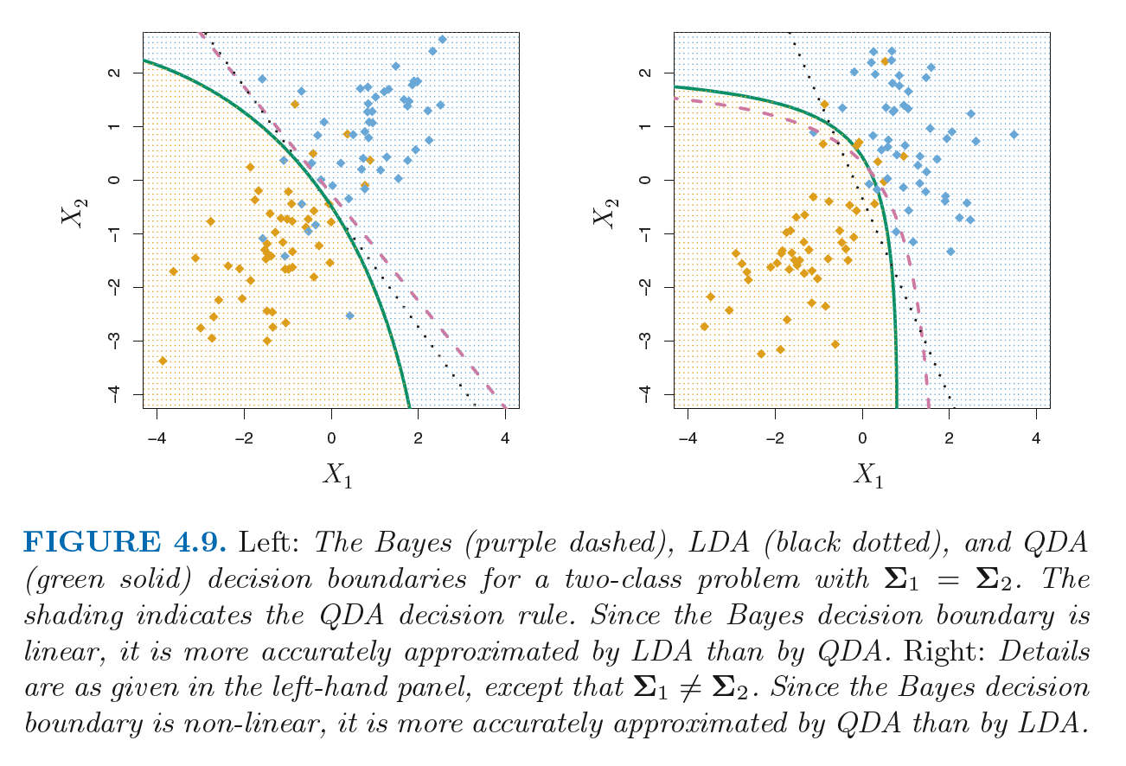

Slide 36
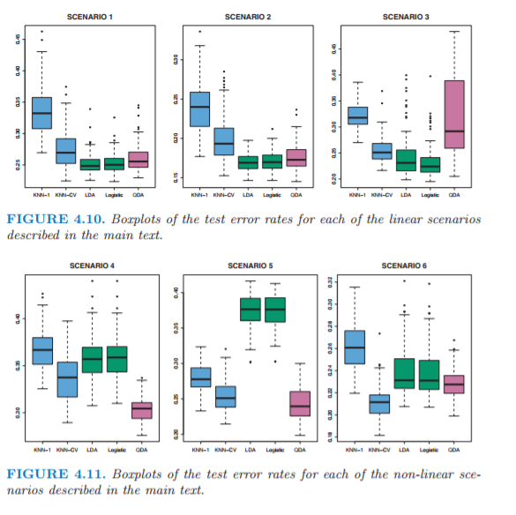
Comparison of classifiers

Slide 37
Comparison of classifiers
LDA assumes that the observations are drawn from a Gaussian distribution with a common covariance matrix in each class, and so can provide some improvements over logistic regression when this assumption approximately holds.
When the true decision boundaries are linear, then the LDA and logistic regression approaches will tend to perform well.
When the boundaries are moderately non-linear, QDA may give better results.
Finally, for much more complicated decision boundaries, a non-parametric approach such as KNN can be superior. But the level of smoothness for a non-parametric approach must be chosen carefully

Slide 38
